Slide 1
Isaiah 22:1-8
ישעיהו כב:א-ח
Isaiah / ישעיה
http://www.matsati.com

Slide 2
Midrash (1)
Legends of the Jews (1)
Liturgy (2)
Kos Eliyahu on Pesach Haggadah (1)
Simchat HaRegel on Pesach Haggadah (1)
Musar (3)
Shenei Luchot HaBerit (3)
Tanakh Commentary (9)
Chizkuni (1)
Rabbeinu Bahya (2)
Tur HaArokh (1)
Or HaChaim on Exodus (4)
Or HaChaim on Deuteronomy (1)
Talmud Commentary (1)
Daf Shevui to Avodah Zarah (1)
ספר שמות פרק כד
ז וַיִּקַּח סֵפֶר הַבְּרִית וַיִּקְרָא בְּאָזְנֵי הָעָם וַיֹּאמְרוּ כֹּל אֲשֶׁר-דִּבֶּר יְהוָֹה נַעֲשֶֹה וְנִשְׁמָע:
Shemot / Exodus 24:7
24:7 And he took the book of the covenant, and read in the audience of the people: and they said, All that the Lord hath said will we do, and be obedient. (KJV)
Read Exodus 19:1-9
Isaiah / ישעיה
http://www.matsati.com

Slide 3
Shemot / Exodus 24:7
Isaiah / ישעיה
http://www.matsati.com

Slide 4
﻿ספר ישעיה פרק כב
﻿א מַשָּׂא גֵּיא חִזָּיוֹן מַה-לָּךְ אֵפוֹא כִּי-עָלִית כֻּלָּךְ לַגַּגּוֹת: ב תְּשֻׁאוֹת | מְלֵאָה עִיר הוֹמִיָּה קִרְיָה עַלִּיזָה חֲלָלַיִךְ לֹא חַלְלֵי-חֶרֶב וְלֹא מֵתֵי מִלְחָמָה: ג כָּל-קְצִינַיִךְ נָדְדוּ-יַחַד מִקֶּשֶׁת אֻסָּרוּ כָּל-נִמְצָאַיִךְ אֻסְּרוּ יַחְדָּו מֵרָחוֹק בָּרָחוּ: ד עַל-כֵּן אָמַרְתִּי שְׁעוּ מִנִּי אֲמָרֵר בַּבֶּכִי אַל-תָּאִיצוּ לְנַחֲמֵנִי עַל-שֹׁד בַּת-עַמִּי: ה כִּי יוֹם מְהוּמָה וּמְבוּסָה וּמְבוּכָה לַאדֹנָי יְהֶוִֹה צְבָאוֹת בְּגֵיא חִזָּיוֹן מְקַרְקַר קִר וְשׁוֹעַ אֶל-הָהָר: ו וְעֵילָם נָשָֹא אַשְׁפָּה בְּרֶכֶב אָדָם פָּרָשִׁים וְקִיר עֵרָה מָגֵן: ז וַיְהִי מִבְחַר-עֲמָקַיִךְ מָלְאוּ רָכֶב וְהַפָּרָשִׁים שֹׁת שָׁתוּ הַשָּׁעְרָה: ח וַיְגַל אֵת מָסַךְ יְהוּדָה וַתַּבֵּט בַּיּוֹם הַהוּא אֶל-נֶשֶׁק בֵּית הַיָּעַר:
Isaiah / ישעיה
http://www.matsati.com

Slide 5
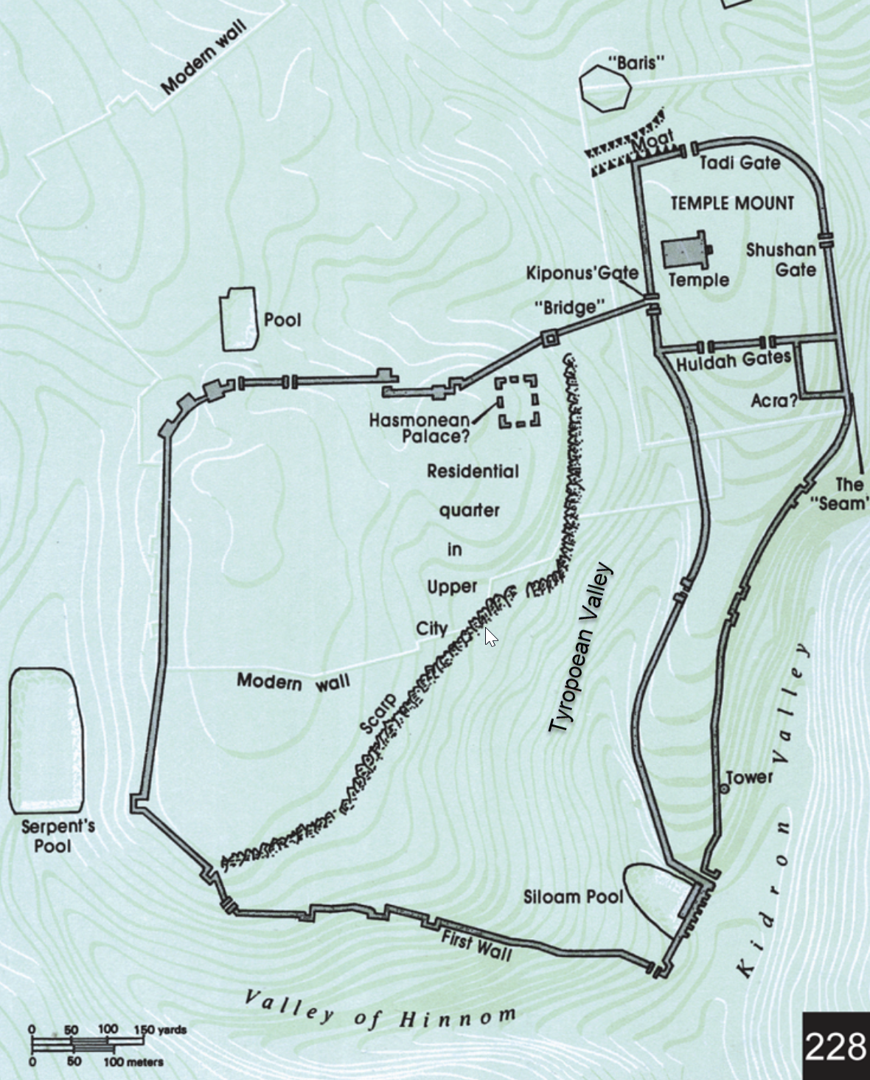
ספר ישעיה פרק כב א מַשָּׂא גֵּיא חִזָּיוֹן מַה-לָּךְ אֵפוֹא כִּי-עָלִית כֻּלָּךְ לַגַּגּוֹת:
Scholars argue over what valley this is referring to, it is interesting to note that the Hinnom, Kidron, and Tyropoean valleys meet at the foot of the hill on which David’s city stood. Note the topographical map showing the joining of these three valleys at the foot of the city.
Isaiah / ישעיה
http://www.matsati.com

Slide 6
Searched for “Host of Heaven
The roof tops are associated with idolatry, the worship of the host of heaven. We note the references to the worship of the host of heaven and how this is also coupled to Asherim worship. Deuteronomy 4:19, 17:3, 2 Kings 17:16, 21:3, Jeremiah 8:2, Zephaniah 1:5, Nahum 9:6, 2 Chronicles 33:3)
Isaiah / ישעיה
http://www.matsati.com

Slide 7
Mark 13:23
“But take heed; behold, I have told you everything in advance.” (NASB, ܐܱܢ̄ܬܾ݁ܘܢ ܕܷ݁ܝܢ ܂ ܐܷܙܕܱ݁ܗ̄ܪܘ ܂ ܗܳܐ ܩܰܕ݁ܡܶܬ݂ ܐܷܡܪܷܬ݂ ܠܟ݂ܽܘܢ ܂ ܟܾ݁ܠ ܡܶܕܷ݁ܡ ܀ 23 ὑμεῖς δὲ βλέπετε· προείρηκα ὑμῖν πάντα. )
1 Thessalonians 5:3-4
5:3 While they are saying, “Peace and safety!” then destruction will come upon them suddenly like birth pangs upon a woman with child; and they shall not escape. 5:4 But you, brethren, are not in darkness, that the day should overtake you like a thief; (NASB, ܟܱ݁ܕ݂ ܢܺܐܡܪܾܘܢ ܕܱ݁ܫܠܴܡܳܐ ܗ̄ܘ ܘܫܰܝܢܳܐ ܆ ܘܗܳܝܕܷ݁ܝܢ ܡܶܢܫܶܠܝܳܐ ܢܩܽܘܡ ܥܠܱܝܗܽܘܢ ܐܱܒ݂ܕܴ݁ܢܳܐ ܇ ܐܱܝܟ݂ ܚܶܒ݂̈ܠܷܐ ܥܰܠ ܒܱ݁ܛܢܬ݂ܴܐ ܂ ܘܠܴܐ ܢܰܡܕ݂ܽܘܢ ܂ܐܱܢ̄ܬܾ݁ܘܢ ܕܷ݁ܝܢ ܐܱܚܰܝ̈ ܆ ܠܴܐ ܗܘܰܝܬܾ݁ܘܢ ܒ݁ܚܶܫܽܘܟ݂ܳܐ ܇ ܕ݁ܗܰܘ ܝܰܘܡܳܐ ܐܱܝܟ݂ ܓܱ݁ܢܳܒ݂ܳܐ ܢܰܕ݂ܪܷܟ݂ܟ݂ܽܘܢ ܂, ὅταν λέγωσιν· εἰρήνη καὶ ἀσφάλεια, τότε αἰφνίδιος αὐτοῖς ἐπίσταται ὄλεθρος ὥσπερ ἡ ὠδὶν τῇ ἐν γαστρὶ ἐχούσῃ, καὶ οὐ μὴ ἐκφύγωσιν. Ὑμεῖς δέ, ἀδελφοί, οὐκ ἐστὲ ἐν σκότει, ἵνα ἡ ἡμέρα ὑμᾶς ὡς κλέπτης καταλάβῃ· πάντες γὰρ ὑμεῖς υἱοὶ φωτός ἐστε καὶ υἱοὶ ἡμέρας· οὐκ ἐσμὲν νυκτὸς οὐδὲ σκότους.)
Isaiah / ישעיה
http://www.matsati.com

Slide 8
Isaiah 22:2-3
Isaiah / ישעיה
http://www.matsati.com

Slide 9
Luke 19:41-44
19:41 And when He approached, He saw the city and wept over it, 19:42 saying, “If you had known in this day, even you, the things which make for peace! But now they have been hidden from your eyes. 19:43 “For the days shall come upon you when your enemies will throw up a bank before you, and surround you, and hem you in on every side, 19:44 and will level you to the ground and your children within you, and they will not leave in you one stone upon another, because you did not recognize the time of your visitation.” (NASB, ܘܟ݂ܰܕ݂ ܩܪܷܒ݂ ܘܰܚܙܳܗ ܠܱܡܕ݂ܺܝܢ̄ܬܴ݁ܐ ܆ ܒ݁ܟ݂ܳܐ ܥܠܷܝܗ ܂ܘܶܐܡܰܪ ܂ ܐܷܠܾܘ ܟܱ݁ܝ ܝܳܕ݂ܰܥܬ݁ܝ ܐܱܝܠܷܝܢ ܕܻ݁ܐܝܬ݂ܱܝܗܶܝܢ ܕܱ݁ܫܠܴܡܶܟ݂ܝ ܞ ܐܴܦ݂ܶܢ ܒ݁ܗܳܢܳܐ ܝܰܘܡܶܟ݂ܝ ܆ ܗܳܫܳܐ ܕܷ݁ܝܢ ܐܷܬ݂ܟܱ݁ܣܺܝ ܠܗܶܝܢ ܡܶܢ ܥܰܝܢܰܝ̈ܟ݁ܝ ܂ ܢܺܐܬ݂ܾܘܢ ܠܷܟ݂ܝ ܕܷ݁ܝܢ ܝܱ̈ܘܡܳܬ݂ܴܐ ܆ ܕ݁ܢܶܚܕ݁ܪܾܘܢܶܟ݂ܝ ܒ݁ܥܶܠܕ݁ܒ݂ܳܒ݂ܰܝ̈ܟ݁ܝ ܆ ܘܢܶܐܠܨܾܘܢܶܟ݂ܝ ܡܶܢ ܟܾ݁ܠ ܕܾ݁ܘܟܴ݁ܐ ܂ ܘܢܶܣܚܦ݂ܽܘܢܶܟ݂ܝ ܁ ܘܠܱܒ݂ܢܱ̈ܝܟ݁ܝ ܒ݁ܓ݂ܰܘܶܟ݂ܝ ܂ ܘܠܴܐ ܢܶܫܒ݁ܩܽܘܢ ܒܷ݁ܟ݂ܝ ܟܻ݁ܐܦ݂ ܥܰܠ ܟܻ݁ܐܦ݂ ܆ ܚܠܴܦ݂ ܕ݁ܠܴܐ ܝܺܕ݂ܰܥܬ݁ܝ ܙܰܒ݂ܢܳܐ ܕ݁ܣܽܘܥܪܴܢܶܟ݂ܝ ܀ 41 Καὶ ὡς ἤγγισεν, ἰδὼν τὴν πόλιν ἔκλαυσεν ἐπʼ αὐτὴν 42 λέγων ὅτι εἰ ἔγνως ἐν τῇ ἡμέρᾳ ταύτῃ καὶ σὺ τὰ πρὸς εἰρήνην· νῦν δὲ ἐκρύβη ἀπὸ ὀφθαλμῶν σου. 43 ὅτι ἥξουσιν ἡμέραι ἐπὶ σέ, καὶ περιβαλοῦσιν οἱ ἐχθροί σου χάρακά σοι καὶ περικυκλώσουσίν σε καὶ συνέξουσίν σε πάντοθεν 44 καὶ ἐδαφιοῦσίν σε καὶ τὰ τέκνα σου ἐν σοὶ καὶ οὐκ ἀφήσουσιν λίθον ἐπὶ λίθον ἐν σοί, ἀνθʼ ὧν οὐκ ἔγνως τὸν καιρὸν τῆς ἐπισκοπῆς σου.)
Isaiah / ישעיה
http://www.matsati.com

Slide 10
Philippians 3:10-12
3:10 That I may know him, and the power of his resurrection, and the fellowship of his sufferings, being made conformable unto his death; 3:11 If by any means I might attain unto the resurrection of the dead. 3:12 Not as though I had already attained, either were already perfect: but I follow after, if that I may apprehend that for which also I am apprehended of Christ Jesus. (KJV, ܕ݁ܒ݂ܳܗ ܐܷܫܬܱ݁ܘܕܱ݁ܥ ܠܝܶܫܽܘܥ ܘܰܠܚܰܝܠܴܐ ܕܱ݁ܩܝܳܡܬܷ݁ܗ ܇ ܘܶܐܫܬܱ݁ܘܬܱ݁ܦ݂ ܒ݁ܚܰܫܰܘܗ̄ܝ̈ ܁ ܘܶܐܬ݁ܕܱ݁ܡܶܐ ܒ݁ܡܰܘܬܷ݁ܗ ܇ܕܱ݁ܠܡܳܐ ܐܷܫܟܱ݁ܚ ܐܷܡܰܛܷܐ ܠܱܩܝܳܡܬܴ݁ܐ ܕ݁ܡܶܢ ܒܷ݁ܝܬ݂ ܡܺܝ̈ܬ݂ܷܐ ܂ ܠܴܐ ܗ̄ܘܳܐ ܡܶܢ ܟܱ݁ܕܾ݁ܘ ܢܶܣܒܷ݁ܬ݂ ܂ ܐܱܘ ܡܶܢ ܟܱ݁ܕܾ݁ܘ ܐܷܬ݂ܓܱ݁ܡܪܷܬ݂ ܂ ܐܷܠܴܐ ܪܴܗܶܛ ܐ̱ܢܳܐ ܆ ܕܱ݁ܠܡܳܐ ܐܱܕ݂ܪܷܟ݂ ܠܡܶܕܷ݁ܡ ܕ݁ܡܶܛܾܠܴܬ݂ܷܗ ܐܱܕ݂ܪܟ݂ܰܢܝ ܝܶܫܽܘܥ ܡܫܺܝܚܳܐ ܁܀܁܀܁ 10 τοῦ γνῶναι αὐτὸν καὶ τὴν δύναμιν τῆς ἀναστάσεως αὐτοῦ καὶ κοινωνίαν παθημάτων αὐτοῦ συμμορφιζόμενος τῷ θανάτῳ αὐτοῦ, 11 εἴ πως καταντήσω εἰς τὴν ἐξανάστασιν τὴν ἐκ νεκρῶν. 12 οὐχ ὅτι ἤδη ἔλαβον ἢ ἤδη τετελείωμαι, διώκω δὲ εἰ καὶ καταλάβω ἐφʼ ᾧ καὶ κατελήμφθην ὑπὸ χριστοῦ Ἰησοῦ.)
Isaiah / ישעיה
http://www.matsati.com

Slide 11
DSS 4Q371 (4QapocrJosepha) 4QApocryphon of Joseph
4 [a place] in the valley of the vision [and …] Zion, and [t]he[y] made [… and turned]
5 [Jerusalem into ruins and the mountain] of my God into a [wooded] heig[ht …]
6 […] the laws of [God, and Judah as well,]
7 [together with him, and he st]ood [at a crossroads,] to d[o …]
8 [to be together with his two brothers. And while] all this happened, Joseph [was thrown into lands]
Jubilees (Pseudepigrapha) 23:13
23:13* because plague (came) upon plague, and wound upon wound, and affliction upon affliction, and evil report upon evil report, and sickness upon sickness, and every evil judgment of this sort one with another: sickness, and downfall, and sleet, and hail, and frost, and fever, and chills, and stupor, and famine, and death, and sword, and captivity, and all plagues, and suffering.”
Isaiah / ישעיה
http://www.matsati.com

Slide 12
Jubilees (Pseudepigrapha) 36:10
36:10 And on the day of turmoil and execration and indignation and wrath, (then) with devouring burning fire just as he burned Sodom so too he will burn up his land and his city and everything which will be his. And he will be wiped out from the book of the discipline of mankind, and he will not be written (on high) in The Book of Life for (he is written) in the one which will be destroyed and pass on to eternal execration so that their judgment will always be renewed with eternal reproach and execration and wrath and torment and indignation and plagues and sickness.
Testament of Levi (Pseudepigrapha) 10:3-5
3 And you shall act lawlessly in Israel, with the result that Jerusalem cannot bear the presence of your wickedness, but the curtain of the Temple will be torn, so that it will no longer conceal your shameful behavior. 4 You shall be scattered as captives among the nations, where you will be a disgrace and a curse. 5 For the house which the Lord shall choose shall be called Jerusalem, as the book of Enoch the Righteous maintains.
Isaiah / ישעיה
http://www.matsati.com

Slide 13
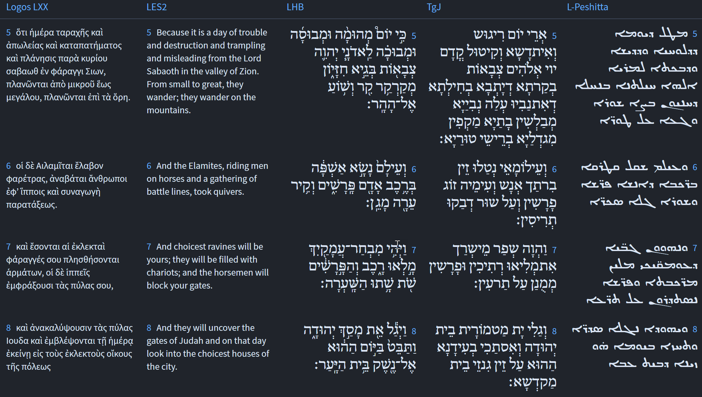
Isaiah 22:5-8
Isaiah / ישעיה
http://www.matsati.com

Slide 14
Rabbinic Literature
ספרות רבנית
Part 2
Isaiah / ישעיה
http://www.matsati.com

Slide 15
Targum Jonathan son of Uziel Isaiah 22:1-8
22:1 THE BURDEN OF THE PROPHECY CONCERNING THE CITY THAT DWELLETH IN THE VALLEY, OF WHICH THE PROPHETS PROPHESIED. What aileth you here, that all of you are gone up to the housetops? 22:2 On account of the tumult wherewith the praiseworthy, the fortified, the joyous city is filled. Thy slain were not slain by the sword, neither did they die in battle. 22:3 All thy rulers have been led forth; from before the bent bow, they are gone into captivity together: all that were found in thee have been slain, together they have fled afar. 22:4 Wherefore I said: Leave off from me, I will weep bitterly, seek ye not to comfort me for the desolation of the congregation of my people. 22:5 For it is a day of tumult, and of treading under foot, and of slaughter before the Lord, the God of hosts, against the city that dwelleth in the valley, against which the prophets prophesied. Thy search the houses, they encompass the towers which are on the tops of the mountains. 22:6 And the Elamites have taken arms in the chariot of a man, and with him are a couple of horsemen, and on the wall they hang the shields. 22:7 And it shall come to pass that the most beautiful of thy valleys shall be filled with chariots; and the horsemen shall be set against the gates. 22:8 And he shall discover the covering of Judah, and he shall look at that time upon the arms of the house of the treasury of the sanctuary. (TgJ)
Isaiah / ישעיה
http://www.matsati.com

Slide 16
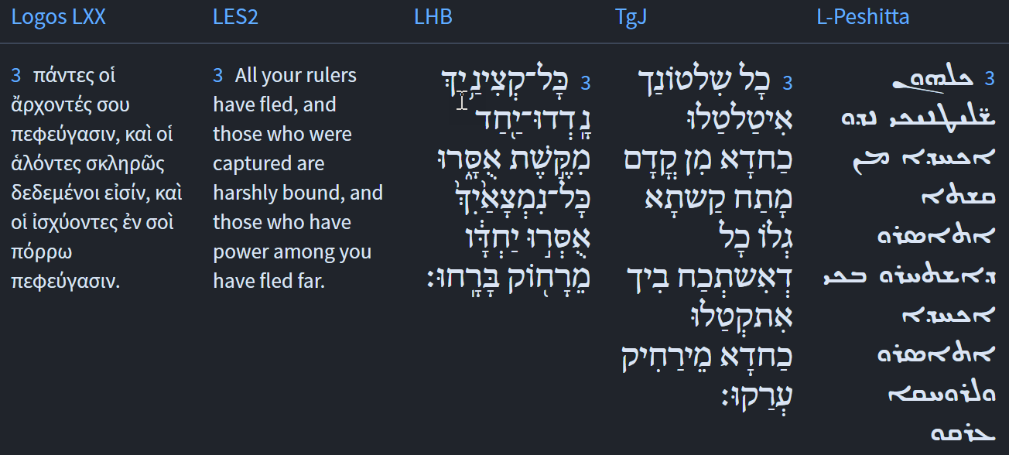
Exodus 22:3
Isaiah / ישעיה
http://www.matsati.com

Slide 17
Ibn Ezra on Isaiah 22,1 Part 1-2
משא גיא חזיון. ירושלם שהיא מקום הנבואה: The valley of vision. Jerusalem, the centre of all prophecies.
יש אומרים כי טעם עלית לגגות לקטר למלאכת השמים, ולפי דעתי שהטעם עלותם לראות החיילות הצרות על ירושלם כי כן מנהג המדינות: Thou art wholly gone up to the house-tops. Some think, they went up in order to offer incense to the host of heaven, but my opinion is, that they went up in order to see the force that besieged Jerusalem, as is generally done under such circumstances.
JPS 1985 Footnotes, Isaiah 22:2
Vv. 1–3 describe a scene of mourning to take place in Jerusalem in the near future. In the ancient Near East, public weeping took place on the low flat roofs as well as in the streets and squares; cf. above, 15.3; Jer. 48.38.
Isaiah / ישעיה
http://www.matsati.com

Slide 18
Searching references to “keys” produces the following results: It is interesting that Luke 11:52 speaks to the keys of knowledge in reference to the Torah, and Revelation 1:18 to Yeshua having the keys to death and hades (hell) and the key of David (Revelation 3:7). These things tie together the concepts of authority, righteousness, holiness, and the destruction of the Temple.
Isaiah / ישעיה
http://www.matsati.com

Slide 19
Talmud Bavli Taanith 29a
אַנְתְּ צְבֵית לְ[אַ]חְרוֹבֵי בֵּיתָא — יְדָךְ אַשְׁלֵימְתְּ לֵיהּ. You want to destroy the Temple; I have given you your hand. It is as though one idol said to the other: You are seeking to destroy the Temple by causing Israel to pray to you; I, too, give you a hand to assist you.
בְּתִשְׁעָה בְּאָב נִגְזַר עַל אֲבוֹתֵינוּ שֶׁלֹּא יִכָּנְסוּ לָאָרֶץ, מְנָלַן — דִּכְתִיב: ״וַיְהִי בַּחֹדֶשׁ הָרִאשׁוֹן בַּשָּׁנָה הַשֵּׁנִית בְּאֶחָד לַחֹדֶשׁ הוּקַם הַמִּשְׁכָּן״. וְאָמַר מָר: שָׁנָה רִאשׁוֹנָה עָשָׂה מֹשֶׁה אֶת הַמִּשְׁכָּן, שְׁנִיָּה הֵקִים מֹשֶׁה אֶת הַמִּשְׁכָּן, וְשָׁלַח מְרַגְּלִים. וּכְתִיב: ״וַיְהִי בַּשָּׁנָה הַשֵּׁנִית בַּחֹדֶשׁ הַשֵּׁנִי בְּעֶשְׂרִים בַּחֹדֶשׁ נַעֲלָה הֶעָנָן מֵעַל מִשְׁכָּן הָעֵדֻת״. § The mishna taught: On the Ninth of Av, it was decreed upon our ancestors that they would not enter Eretz Yisrael. The Gemara asks: From where do we derive this? As it is written: “And it came to pass in the first month in the second year, on the first day of the month, that the Tabernacle was erected” (Exodus 40:17). And the Master said: In the first year after leaving Egypt, Moses built the Tabernacle. At the beginning of the second year, Moses erected the Tabernacle and sent the spies. And it is written: “And it came to pass in the second year in the second month, on the twentieth day of the month, that the cloud was taken up from the Tabernacle of the Testimony” (Numbers 10:11).
וּכְתִיב: ״וַיִּסְעוּ מֵהַר ה׳ דֶּרֶךְ שְׁלֹשֶׁת יָמִים״. אָמַר רַבִּי חָמָא בַּר חֲנִינָא: אוֹתוֹ הַיּוֹם סָרוּ מֵאַחֲרֵי ה׳. וּכְתִיב: ״וְהָאסַפְסֻף אֲשֶׁר בְּקִרְבּוֹ הִתְאַוּוּ תַּאֲוָה וַיָּשֻׁבוּ וַיִּבְכּוּ גַּם בְּנֵי יִשְׂרָאֵל וְגוֹ׳״, וּכְתִיב: ״עַד חֹדֶשׁ יָמִים וְגוֹ׳״ — דְּהָווּ לְהוּ עֶשְׂרִין וְתַרְתֵּין בְּסִיוָן, And it is further written: “And they set forward from the mount of the Lord three days’ journey” (Numbers 10:33). Rabbi Ḥama bar Ḥanina said: That very day, they turned away from God by displaying their anxiety about leaving Mount Sinai. And it is written: “And the mixed multitude that was among them fell a lusting, and the children of Israel also wept on their part, and said: Would that we were given flesh to eat” (Numbers 11:4). And it is written that the Jews ate the meat “for an entire month” (Numbers 11:20). If one adds to the first twenty days an additional three days’ journey, these are twenty-three days. Consequently, the subsequent month of twenty-nine days of eating meat ended on the twenty-second of Sivan.
Isaiah / ישעיה
http://www.matsati.com

Slide 20
Jerusalem Talmud Yoma 1:1:20
¹¹⁸Babli 9a/9b. We find that the Temple was destroyed the first time only because they were active idolators, and uncoverers of nakedness¹¹⁹The technical term for incest and adultery (all crimes prohibited in Lev. 18.), and spillers of blood. And so the second time. Rebbi Joḥanan ben Torta said, we find that Shiloh was destroyed only because they slighted the holidays and desecrated the sancta. We find that the Temple was destroyed the first time only because they were active idolators, and uncoverers of nakedness, and spillers of blood. But of the second we know that they toiled in the Torah, were careful about the commandments and tithes, and every good custom¹²⁰Latin suetum (E. G.). was in them; only they loved money and hated one another without reason. Hate without reason is hard for it is the equivalent of idolatry, and uncovering nakedness, and spilling of blood. An example. Rebbi Zeˋira, and Rebbi Jacob bar Aḥa, and Rebbi Abuna, were sitting and saying, it is worse since the first time it was rebuilt but the second time it was not rebuilt. Rebbi Zeˋira said, the first ones repented, the second ones did not repent. Rebbi Eleazar said, the first time their sin was brought into the open and so was their end; the second time their sin was brought into the open but their end was not brought into the open. They asked Rebbi Eliezer, are the later generations more qualified than the first? He told them, your witness, the Temple, shall prove it. Our forefathers removed the ceiling, the curtain of Jehudah was lifted¹²¹Is. 22:8., but we blew out the walls, who are saying, make bare, make bare, up to its foundations¹²²Ps. 137:7.. They said, any generation in which it is not rebuilt is debited as if it had destroyed it.
Isaiah / ישעיה
http://www.matsati.com

Slide 21
The Torah says there is to be only one law for both Jews and aliens sojourning with the Jewish people. (Bamidbar / Numbers 15:15-16)
Isaiah / ישעיה
http://www.matsati.com

